Slide 1
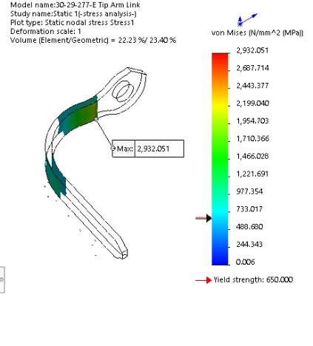
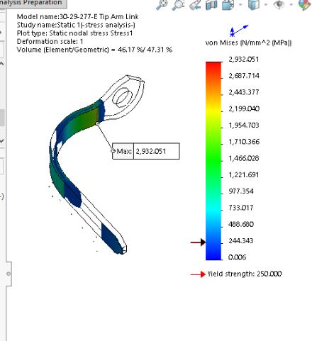
Current tip design, 0.1mm displacement induced stress
BeCu Full Hard condition
BeCu annealed condition

Slide 2
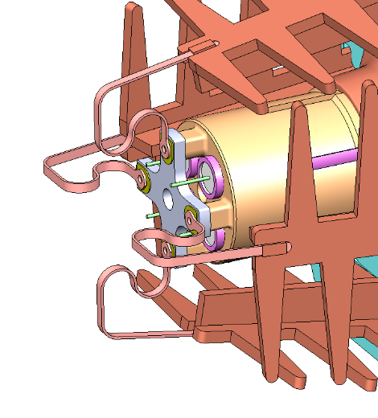
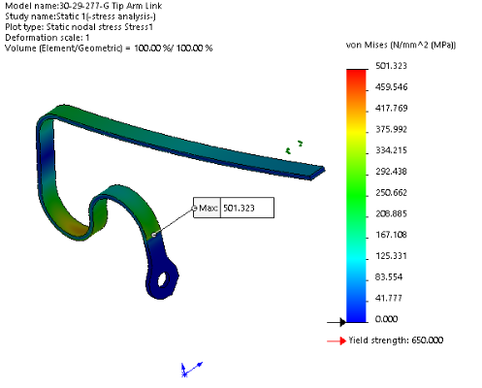
Case 1 - Solder on top of Feed Arm, Complicated geometry, low resulting stress, 0.25mm displacement, full hard

Slide 3
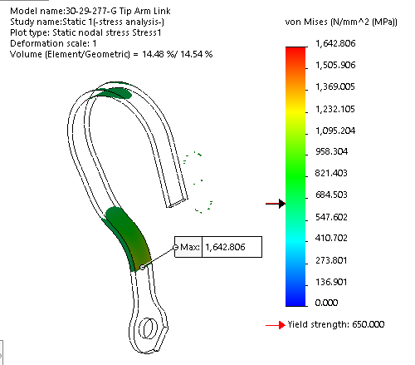
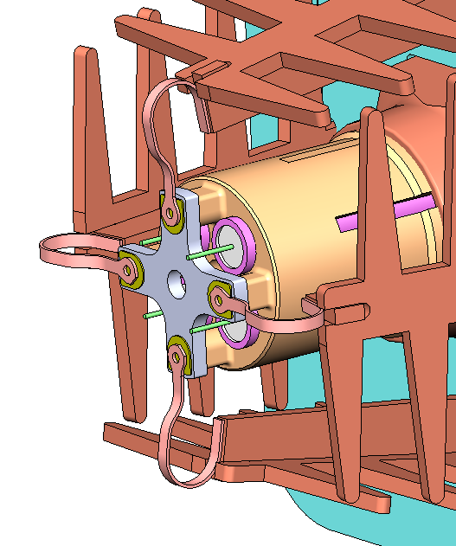
Case 2 - Solder on end of Feed Arm, narrow Link, stress concentration at filter circuit board solder, 0.25mm displacement, full hard

Slide 4
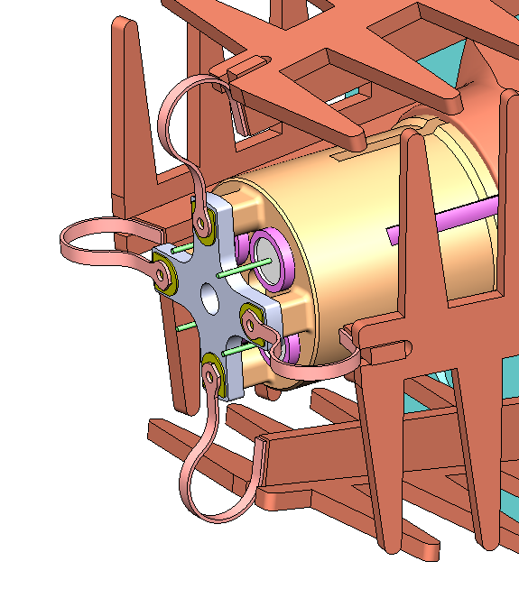
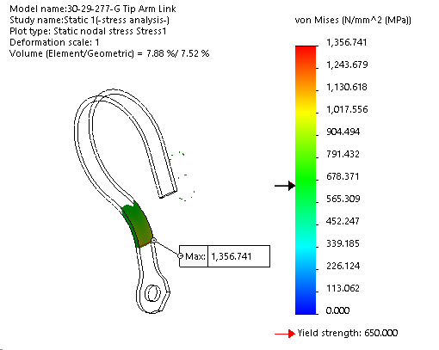
Case 3 - Solder on end of Feed Arm, narrow Link, stress concentration at filter circuit board solder, 0.25mm displacement, full hard

Slide 5
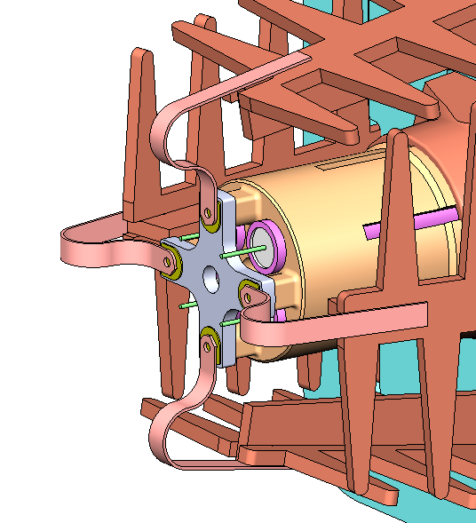
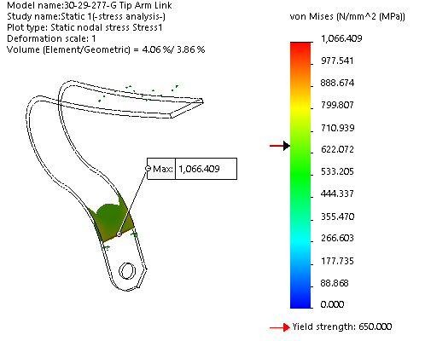
Case 4 - Solder on top of Feed Arm, wide Link, stress concentration at filter circuit board solder, 0.25mm displacement, full hard

Slide 6
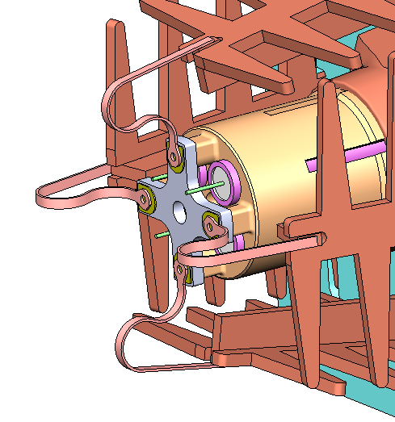
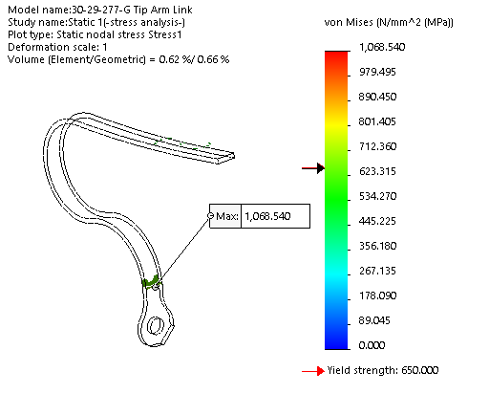
Case 5 - Solder on top of Feed Arm, narrow Link, stress concentration at filter circuit board solder, 0.25mm displacement, full hard

Slide 7
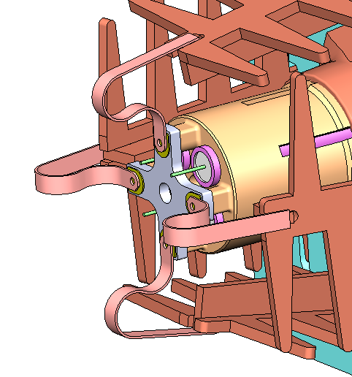
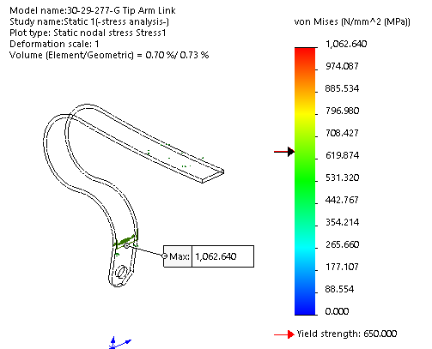
Case 6 - Solder on top of Feed Arm, wide Link, stress concentration at filter circuit board solder, 0.25mm displacement, full hard

Slide 8
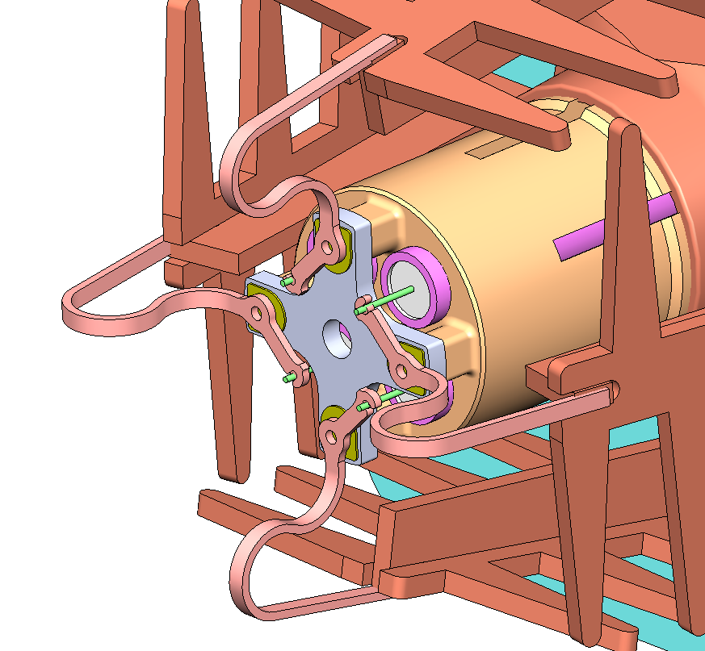
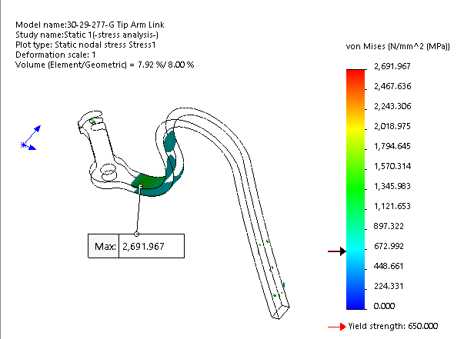
Case 7 - Solder on top of Feed Arm, wide Link, stress concentration at filter circuit board solder, 0.25mm displacement, full hard

